Slide 1



How else can we define Information Flow in Neural Circuits?
Praveen Venkatesh
Dept. of Electrical & Computer Engineering Carnegie Mellon University
with Sanghamitra Dutta and Pulkit Grover
“How should we define Information Flow in Neural Circuits?”, ISIT 2019 “Information Flow in Computational Systems”, IEEE Trans. IT 2020
(https://praveenv253.github.io/publications)

Slide 2
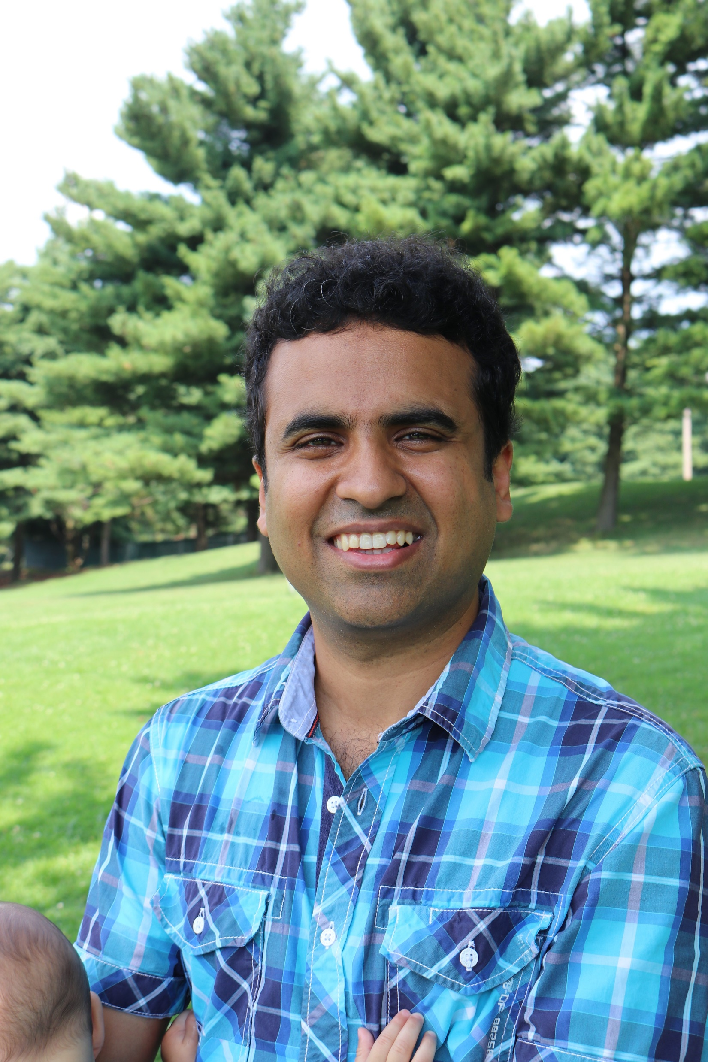
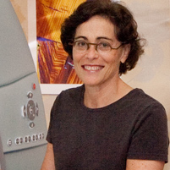


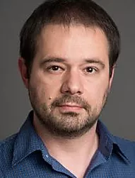
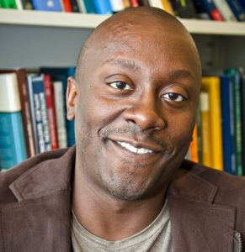
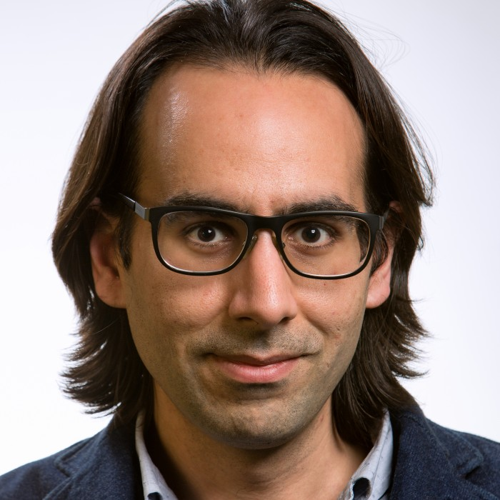
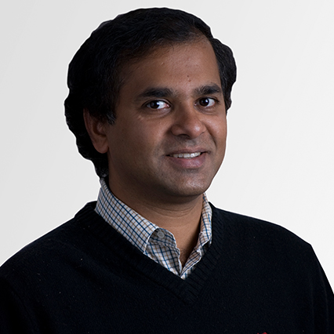

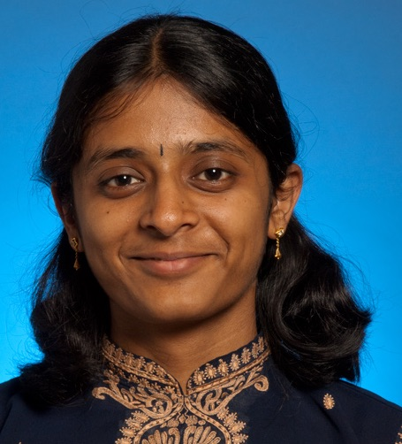


Acknowledgments
Advisor
Neuroscientists
Clinicians
Theorists
Pulkit Grover (CMU)
Marlene Behrmann (CMU)
Rob Kass (CMU)
Mark Richardson (MGH/Harvard)
Vasily Kokkinos (MGH/Hvd)
Todd Coleman (UCSD)
Bobak Nazer (BU)
Venkatesh Saligrama (BU)
Labmates & Colleagues
Fellowships
CMLH Fellowship in Digital Health
Dowd Fellowship
Henry L. Hillman Presidential Fellowship
CIT Dean’s Fellowship
Grants
Sanghamitra Dutta (CMU)
Aditya Gangrade (BU)
Ashwati Krishnan (CMU)
Alireza
Chamanzar
(CMU)
Haewon Jeong (CMU)
Center for Machine Learning and Health
Chuck Noll Foundation for Brain Injury Research

Slide 3
Why study information flow?
Thousands of papers estimating information flow in the brain
Lot of controversy around information flow
Our main insight: controversy exists because “information flow” is not formally defined
(Venkatesh & Grover SfN’15, Allerton’15) (Venkatesh & Grover, Cosyne’19) (Venkatesh, Dutta & Grover, IEEE Trans IT ’20)

Slide 4
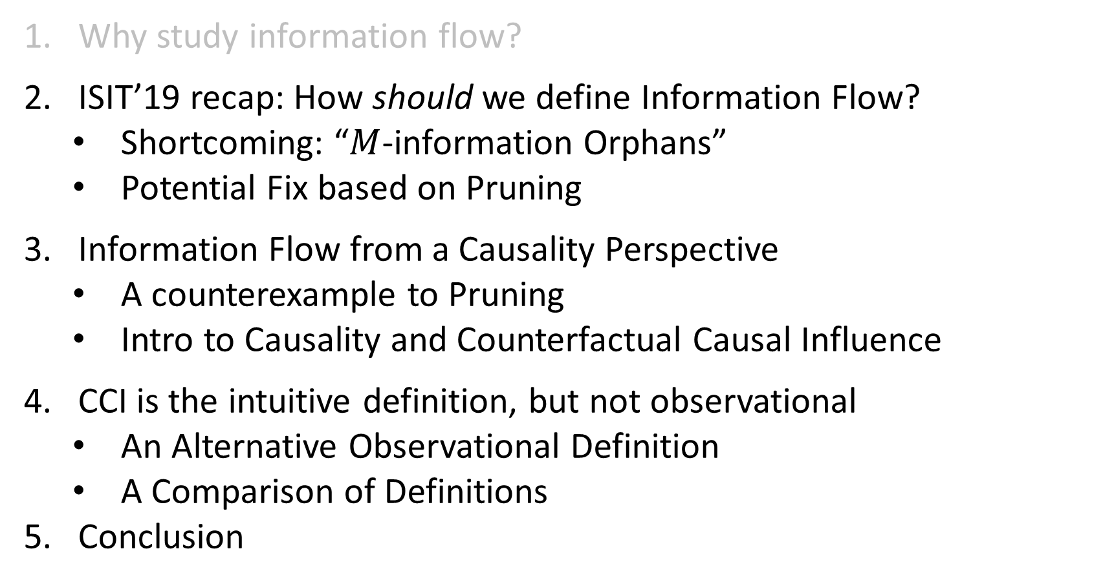
How else can we define Information Flow?
Why study information flow?
ISIT’19 recap: How should we define Information Flow?
Shortcoming: “$M$-information Orphans”
Potential Fix based on Pruning
Information Flow from a Causality Perspective
A counterexample to Pruning
Intro to Causality and Counterfactual Causal Influence
CCI is the intuitive definition, but not observational
An Alternative Observational Definition
A Comparison of Definitions
Conclusion

Slide 5
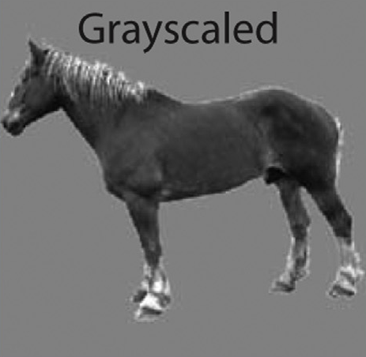
Information flow for Neuroscientific Inferences
Region C
Region B
Info “flows” between brain regions
Info is often about a stimulus
There could be feedback
Region A
(Almeida et al., Cortex, 2013)
“Stimulus”
Goal: Find a definition for information flow, so that we can track info paths

Slide 6
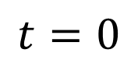

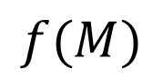
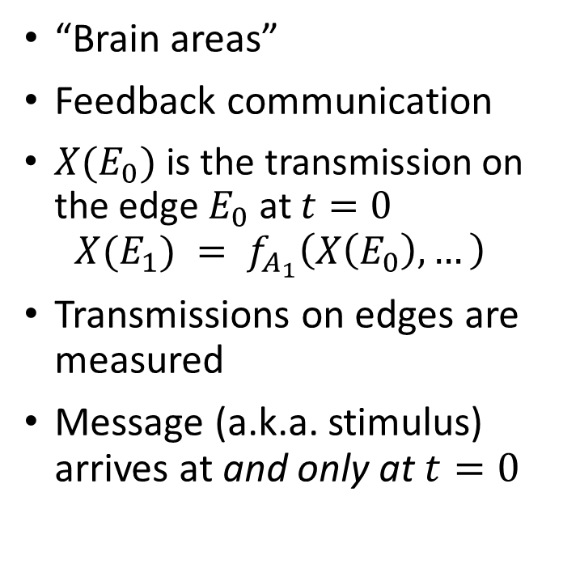

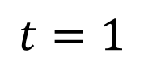

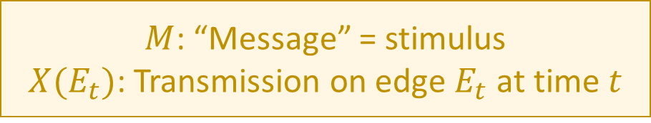
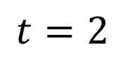
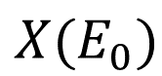





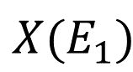


A Computational Model of the Brain
“Brain areas”
Feedback communication
$X(E_{0})$ is the transmission on the edge $E_{0}$at $t=0$ $X(E_{1}) = f_{A_{1}}\left(X\left(E_{0}\right), …\right)$
Transmissions on edges are measured
Message (a.k.a. stimulus) arrives at and only at $t=0$
$$t=0$$
$$t=1$$
$$t=2$$
$$M$$
$$A_{0}$$
$$X(E_{0})$$
$$A_{1}$$
$$X(E_{1})$$
$$A_{2}$$
Region C
Region B
$$B_{0}$$
$$B_{1}$$
$$B_{2}$$
Region A
$$C_{0}$$
$$C_{1}$$
$$C_{2}$$
$$f(M)$$
(Thompson, 1980: VLSI) (Ahlswede et al., 2000: Network Info Theory) (Peters et al., 2016: Causality)
Stimulus
$M$: “Message” = stimulus
$X(E_{t})$: Transmission on edge $E_{t}$ at time $t$

Slide 7


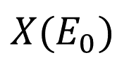
A Computational Model of the Brain
“Brain areas”
Feedback communication
$X(E_{0})$ is the transmission on the edge $E_{0}$at $t=0$ $X(E_{1}) = f_{A_{1}}\left(X\left(E_{0}\right), …\right)$
Transmissions on edges are measured
Message (a.k.a. stimulus) arrives at and only at $t=0$
$$t=0$$
$$t=1$$
$$t=2$$
$$M$$
$$A_{0}$$
$$X(E_{0})$$
$$A_{1}$$
$$X(E_{1})$$
$$A_{2}$$
$$B_{0}$$
$$B_{1}$$
$$B_{2}$$
$$C_{0}$$
$$C_{1}$$
$$C_{2}$$
$$f(M)$$
(Thompson, 1980: VLSI) (Ahlswede et al., 2000: Network Info Theory) (Peters et al., 2016: Causality)
Goal: Define info flow + track info path

Slide 8
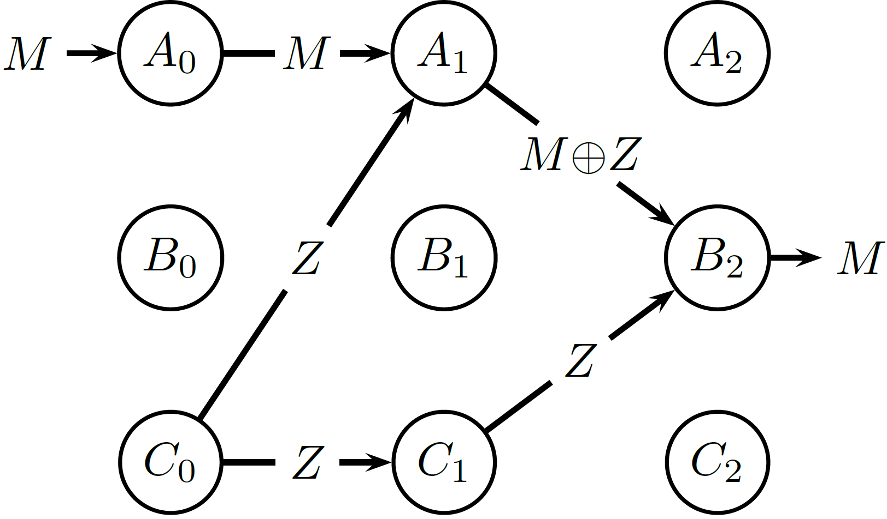
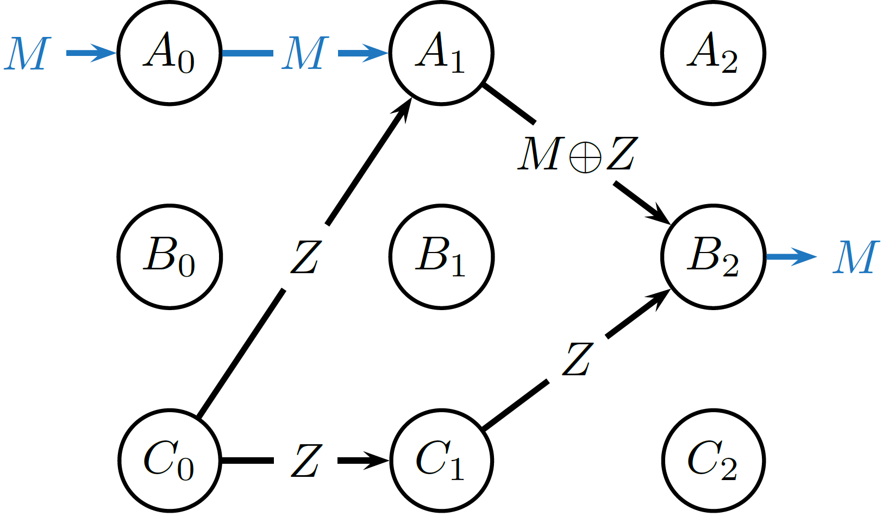

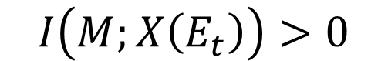
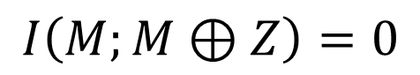

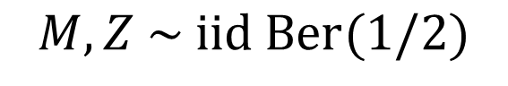
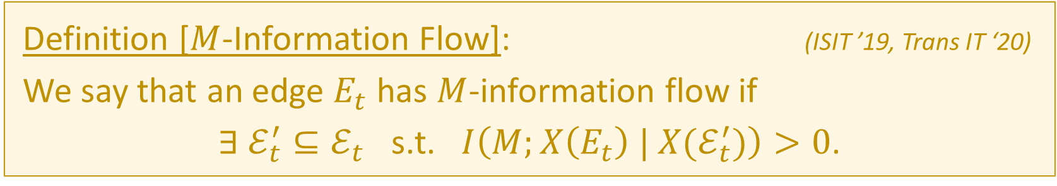
How should we define Information Flow? (ISIT ‘19)
Definition [$M$-Information Flow]: (ISIT ’19, Trans IT ‘20)
We say that an edge $E_{t}$ has $M$-information flow if
$∃ ℰ_{t}^{′}⊆ℰ_{t}$ s.t. $I\left(M;X\left(E_{t}\right) | X(ℰ_{t}^{′})\right)>0$.
Why not a simpler definition like:
$$?$$
$$I\left(M;X\left(E_{t}\right)\right)>0$$
$$M, Z \sim iid Ber(1/2)$$
$$M⊕Z=M xor Z$$
$$I\left(M;M⊕Z\right)=0$$

Slide 9
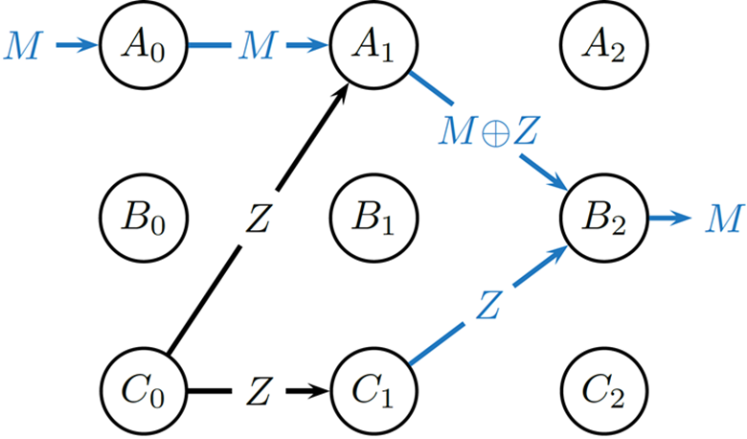
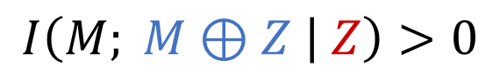


How should we define Information Flow? (ISIT ‘19)
Definition [$M$-Information Flow]: (ISIT ‘19, Trans IT ‘20)
We say that an edge $E_{t}$ has $M$-information flow if
$∃ ℰ_{t}^{′}⊆ℰ_{t}$ s.t. $I\left(M;X\left(E_{t}\right) | X(ℰ_{t}^{′})\right)>0$.
Using the above definition:
Conditioning on $Z$ reveals the dependence between $M⊕Z$ and $M$:
$$I\left(M; M⊕Z | Z\right)>0$$

Slide 10
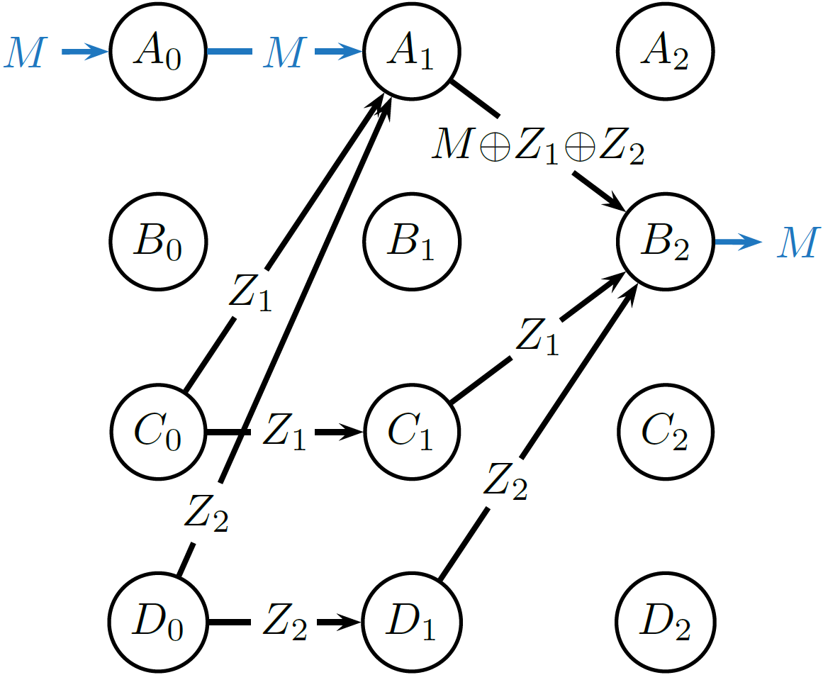
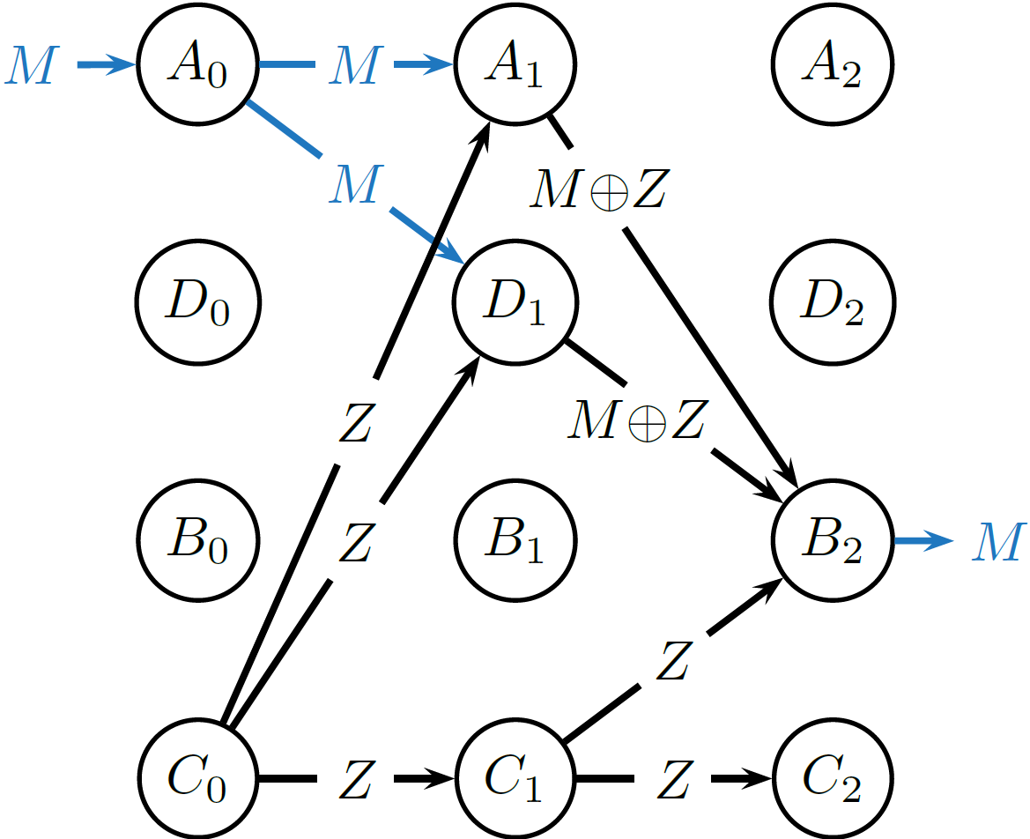
How should we define Information Flow? (ISIT ‘19)
Definition [$M$-Information Flow]: (ISIT ’19, Trans IT ‘20)
We say that an edge $E_{t}$ has $M$-information flow if
$∃ ℰ_{t}^{′}⊆ℰ_{t}$ s.t. $I\left(M;X\left(E_{t}\right) | X(ℰ_{t}^{′})\right)>0$.

Slide 11



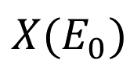
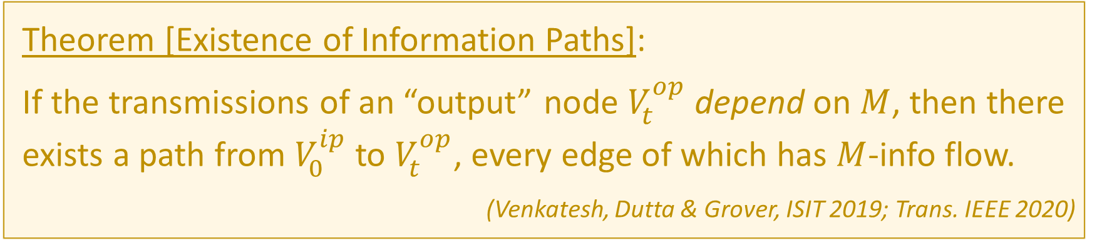






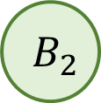
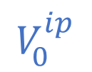
The Existence of Information Paths
$$V_{0}^{ip}$$
$$M$$
$$A_{0}$$
$$X(E_{0})$$
$$A_{1}$$
$$X(E_{1})$$
$$A_{2}$$
$$V_{t}^{op}$$
$$B_{0}$$
$$B_{1}$$
$$B_{2}$$
$$f\left(M\right)$$
Theorem [Existence of Information Paths]:
If the transmissions of an “output” node $V_{t}^{op}$ depend on $M$, then there exists a path from $V_{0}^{ip}$ to $V_{t}^{op}$, every edge of which has $M$-info flow.
(Venkatesh, Dutta & Grover, ISIT 2019; Trans. IEEE 2020)

Slide 12
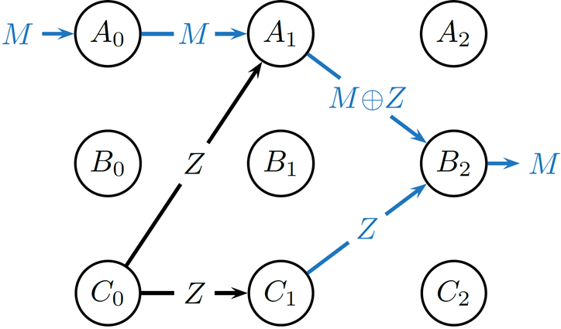

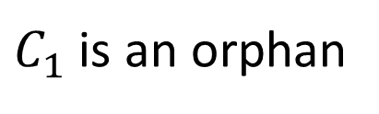

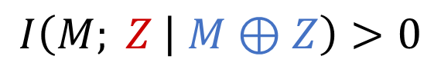
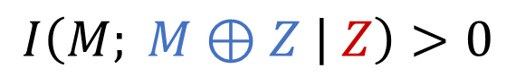
But! This definition gives rise to “Orphans”
An edge $E_{t}$ has $M$-info flow if $∃ ℰ_{t}^{′}⊆ℰ_{t}$ s.t. $I\left(M;X\left(E_{t}\right) | X(ℰ_{t}^{′})\right)>0$.
$M$-info flows out of a node $⇒$ $M$-info flows into the node
$$I\left(M; M⊕Z | Z\right)>0$$
$$I\left(M; Z | M⊕Z\right)>0$$
$C_{1}$ is an orphan
$Z$ has $M$-info flow!

Slide 13
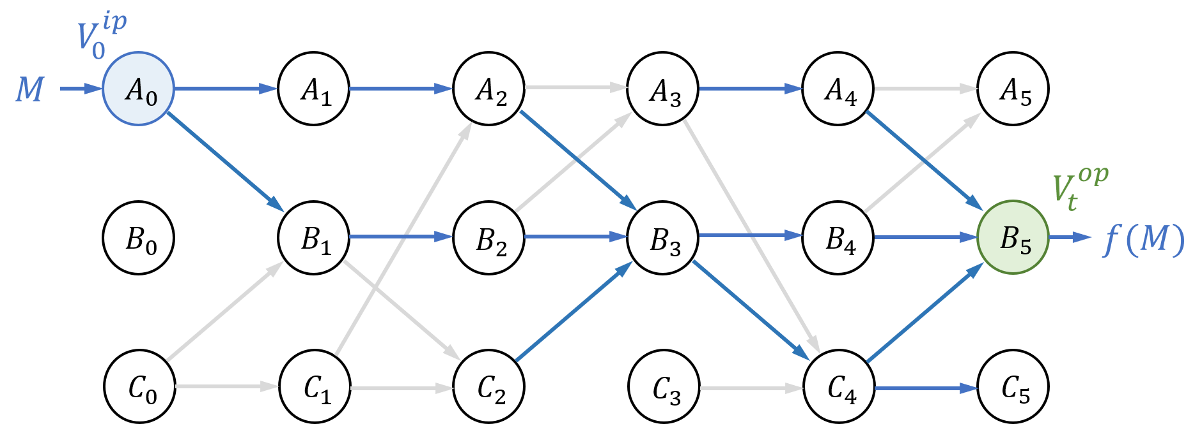
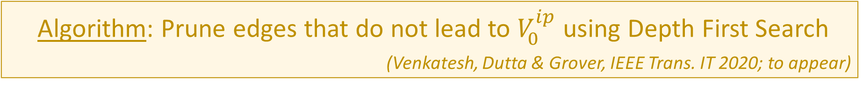
Pruning as a Solution to Orphans
Algorithm: Prune edges that do not lead to $V_{0}^{ip}$ using Depth First Search
(Venkatesh, Dutta & Grover, IEEE Trans. IT 2020; to appear)

Slide 14
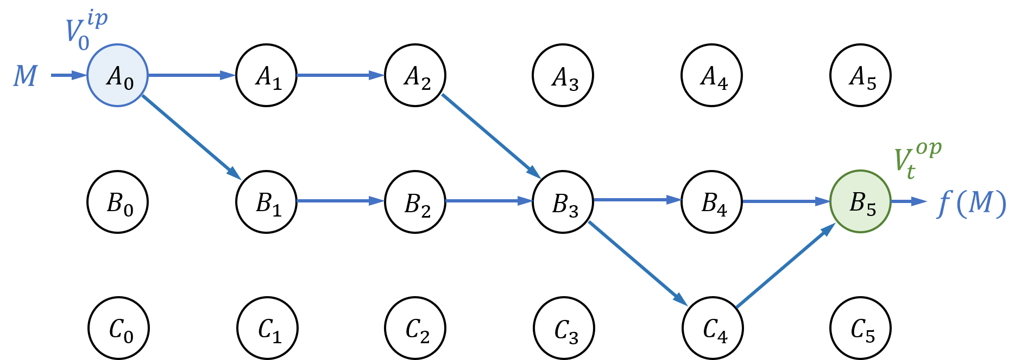
Pruning as a Solution to Orphans
Algorithm: Prune edges that do not lead to $V_{0}^{ip}$ using Depth First Search
(Venkatesh, Dutta & Grover, IEEE Trans. IT 2020; to appear)

Slide 15
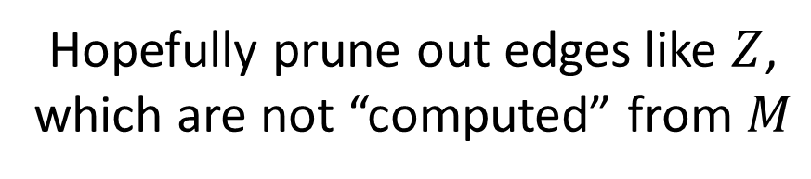
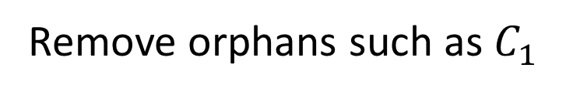
Pruning as a Solution to Orphans
Algorithm: Prune edges that do not lead to $V_{0}^{ip}$ using Depth First Search
(Venkatesh, Dutta & Grover, IEEE Trans. IT 2020; to appear)
Remove orphans such as $C_{1}$
Hopefully prune out edges like $Z$,
which are not “computed” from $M$

Slide 16
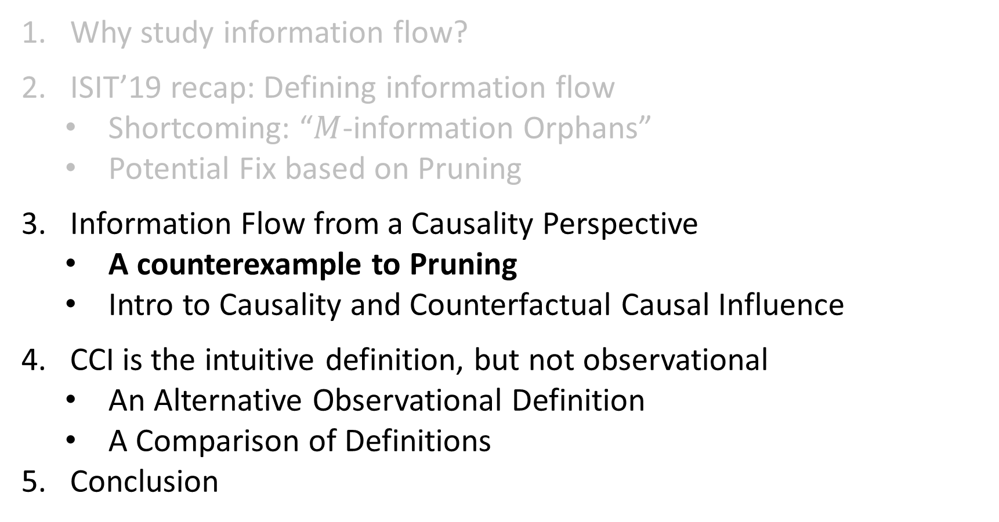
How else can we define Information Flow?
Why study information flow?
ISIT’19 recap: Defining information flow
Shortcoming: “$M$-information Orphans”
Potential Fix based on Pruning
Information Flow from a Causality Perspective
A counterexample to Pruning
Intro to Causality and Counterfactual Causal Influence
CCI is the intuitive definition, but not observational
An Alternative Observational Definition
A Comparison of Definitions
Conclusion

Slide 17
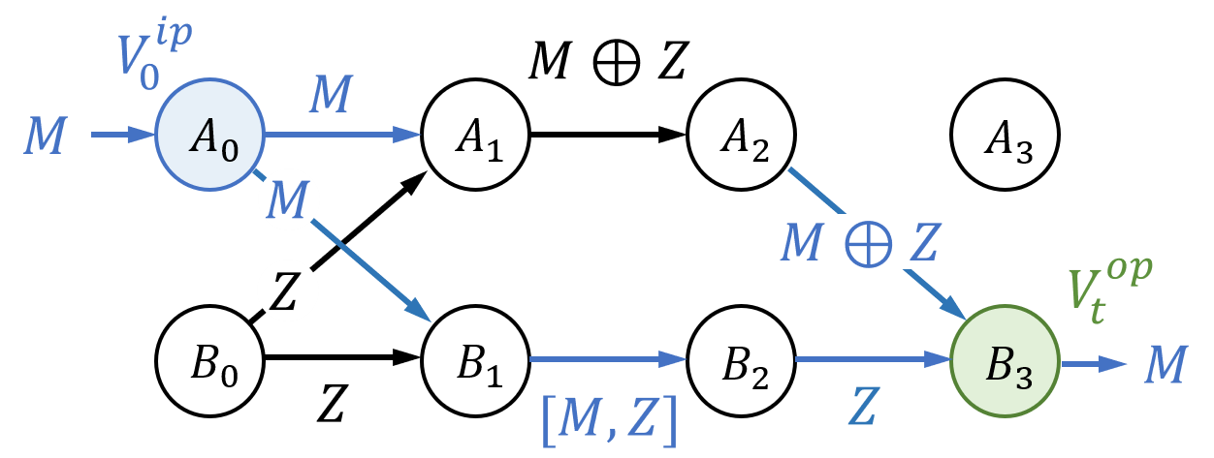
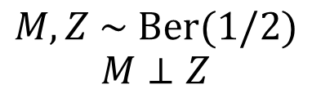
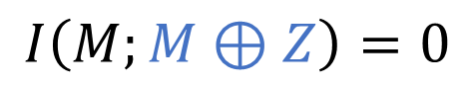
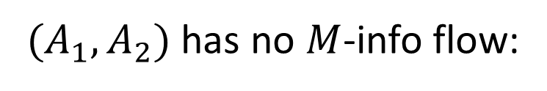

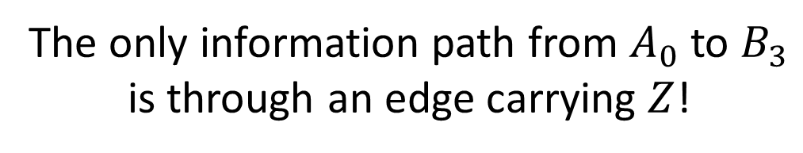
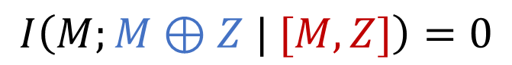
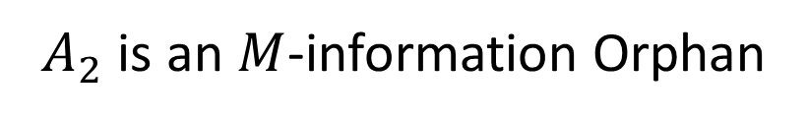
A Counterexample to Pruning (this work)
$$M, Z \sim Ber(1/2)$$
$$M⊥Z$$
$(A_{1},A_{2})$ has no $M$-info flow:
The orphan removed by pruning transmits $M⊕Z$!
$$I\left(M;M⊕Z\right)=0$$
$$I\left(M;M⊕Z | [M,Z]\right)=0$$
The only information path from $A_{0}$ to $B_{3}$ is through an edge carrying $Z$!
$A_{2}$ is an $M$-information Orphan

Slide 18
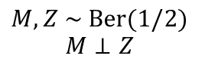




What makes this a Counterexample?
We disliked orphans for two reasons:
No “conservation” of info flow at an orphan
$Z$ is not “computed” from $M$
Is $Z$ really all that different from $M⊕Z$ in these examples?
Joint distribution is symmetric in $M⊕Z$ and $Z$!
Using $Y$ for $M⊕Z$,
$$p\left(m, z, y\right)=\frac{1}{4}𝕀\left\{y=m⊕z\right\}=\frac{1}{4}𝕀\left\{y⊕z=m\right\}$$
$$M, Z \sim Ber(1/2)$$
$$M⊥Z$$
To differentiate, we need to go beyond the joint distribution!

Slide 19





















A Brief Introduction to Causality
Structural Causal Model
Computational System Model
(Peters, Janzing & Schölkopf, “Elements of Causal Inference”, 2016)
(Venkatesh, Dutta & Grover, ISIT 2019; Trans. IT 2020)
$$X_{0}≔x$$
$$X_{2}$$
$$X_{1}$$
$$X_{3}$$
$$M$$
$$A_{0}$$
$$A_{1}$$
$$A_{2}$$
$$X_{5}$$
$${ X}_{0}$$
$$X_{2}$$
$$p\left(X_{5}\right)?$$
$$B_{0}$$
$$B_{1}$$
$$B_{2}$$
$$f(M)$$
$$X_{1}$$
$$X_{4}$$
$$X_{3}$$
$$X_{3}=f_{A_{1}}\left(X_{1},X_{2}, W_{A_{1}}\right)$$
$$X_{i}=f_{i}\left(Pa_{X_{i}}, W_{i}\right)$$
The Computational System is also a Structural Causal Model
Directed Acyclic Graph with functional relationships

Slide 20














Counterfactual Causal Influence (of $M$)
$$=0$$
$$1$$
For a particular realization of all RVs,
What would have happened
(to downstream variables)
If $M$ had taken a different value?
(keeping all other sources of randomness fixed)
$$=0$$
$$1$$
$$=1$$
$$0$$
$$=1$$
$$=0$$
$$1$$
$$=1$$
$$=1$$
We can now differentiate: $M⊕Z$ is CCI’d by $M$, but $Z$ is not!

Slide 21

Counterfactual Causal Influence (of $M$)
$$=0$$
$$1$$
Defining info flow using CCI:
$M$ may be constant over some of its values $m∈ℳ$ e.g. $X\left(E_{t}\right)=𝕀\left\{M≥0\right\}$
$M$ may be constant over all $m$ for some values of $z∈𝒵$ e.g. $X\left(E_{t}\right)=M⋅Z$
$$=0$$
$$1$$
$$=1$$
$$0$$
$$=1$$
$$=0$$
$$1$$
$$=1$$
$$=1$$
We can now differentiate: $M⊕Z$ is CCI’d by $M$, but $Z$ is not!

Slide 22






Defining Info Flow using $M$-CCI
Definition [$M$-Counterfactual Causal Influence]: We say that an edge $E_{t}$ is counterfactually causally influenced by $M$ if
$∃ m,m^{′}∈ℳ$ and $\underline{w}∈\underline{𝒲}$ s.t. ${X\left(E_{t}\right)}^{\left(m,\underline{w}\right)}≠{X\left(E_{t}\right)}^{\left(m^{′}, \underline{w}\right)}$
$M$-information flow
$M$-counterfactual causal influence

Slide 23


Main Results
Definition [$M$-Counterfactual Causal Influence]: We say that an edge $E_{t}$ is counterfactually causally influenced by $M$ if
$∃ m,m^{′}∈ℳ$ and $\underline{w}∈\underline{𝒲}$ s.t. $X^{\left(m,\underline{w}\right)}\left(E_{t}\right)≠X^{\left(m^{′},\underline{w}\right)}\left(E_{t}\right)$
Theorem [$M$-CCI has no orphans]:
If an outgoing edge $E_{t}$ of a node $V_{t}$ is $M$-CCI’d, then there exists some incoming edge $E_{t−1}$ of $V_{t}$ that is also $M$-CCI’d.
Theorem [$M$-CCI guarantees info paths]:
If the transmissions of an “output” node $V_{t}^{op}$ depend on $M$, then there is a path from $V_{0}^{ip}$ to $V_{t}^{op}$ such that every edge of this path is $M$-CCI’d.

Slide 24

How else can we define Information Flow?
Why study information flow?
ISIT’19 recap: Defining information flow
Shortcoming: “$M$-information Orphans”
Potential Fix based on Pruning
Information Flow from a Causality Perspective
A counterexample to Pruning
Intro to Causality and Counterfactual Causal Influence
CCI is the intuitive definition, but not observational
An Alternative Observational Definition
A Comparison of Definitions
Conclusion

Slide 25






CCI is not an Observational Measure
Estimating CCI requires (intrinsic) variables to be held fixed while $M$ is changed
Minimally requires the capability to make interventions
Sometimes may be impossible to estimate
We would like observational measures. But…
Joint distribution is symmetric in $M⊕Z$ and $Z$!
$$p\left(m, z, y\right)=\frac{1}{4}𝕀\left\{y=m⊕z\right\}=\frac{1}{4}𝕀\left\{y⊕z=m\right\}$$
$$M, Z \sim Ber(1/2)$$
$$M⊥Z$$
(using $Y$ for $M⊕Z$)

Slide 26
























An alternative Observational Definition
Can we find an alternative definition which does not suffer from the pruning counterexample?
$$V_{0}^{ip}$$
$$M⊕Z$$
$$M$$
$∃ f:\left[M,Z\right]↦Z$ s.t.
$$M$$
$$A_{0}$$
$$A_{1}$$
$$A_{2}$$
$$A_{3}$$
$$M$$
$$I\left(M; M⊕Z | f\left(\left[M,Z\right]\right)\right)$$
$$M⊕Z$$
$$Z$$
$$V_{t}^{op}$$
$$=I\left(M; M⊕Z | Z\right)>0$$
$$B_{0}$$
$$B_{1}$$
$$B_{2}$$
$$B_{3}$$
$$M$$
$$Z$$
$$[M,Z]$$
$$Z$$
Definition [Modified $M$-Information Flow]:
We say that an edge $E_{t}$ has modified $M$-information flow if
$∃ ℰ_{t}^{′}=\left\{E_{t}^{i}\right\}⊆ℰ_{t}$ and functions $f_{i}$ s.t. $I\left(M;X\left(E_{t}\right) | \{f_{i}∘X\left(E_{t}^{i}\right)\}\right)>0$.

Slide 27





Comparing the three definitions
All definitions have their shortcomings:
$M$-CCI identifies $M⊕Z_{2}$ (but it cannot be decoded)
Modified $M$-info flow identifies $Z_{1}$ (but it cannot help decode $M$)
$M$-CCI $⇔$ $M$-info flow $M$-CCI $⇔$ Modified $M$-info flow
Modified $M$-info flow $⇒$ $M$-info flow
$M$-info flow
$M$-CCI
Modified $M$-info flow

Slide 28











Summary and ongoing work
Information Flow & PID
Neuroengineering: Fundamental Limits and Algorithms
(Venkatesh, Dutta and Grover, ISIT 2019; IEEE Trans. IT 2020, to appear)
AI and Fairness
(Theory: Grover and Venkatesh, Proc. IEEE 2016)
(Fundamental limits: Venkatesh and Grover, ISIT 2017)
(with Improvements by Xu, Coleman in this ISIT!)
(Dutta, Venkatesh, Mardziel, Datta and Grover, AAAI 2020)
(Experimental validation: Robinson, Venkatesh et al., Sci. Rep. 2017)
(Clinical use case: Chaman Zar, …, Venkatesh et al., IEEE Trans. BME 2018)

